Slide 1


Creative thinking in research
Dr. Stephann Makri
Stephann@city.ac.uk
www.stephann.com
@StephannMakri
“The good researcher is not ‘one who knows the right answers’ but ‘one who is struggling to find out what the right questions might be!’”
Philips & Pugh (2010), p. 56.

Slide 2
Introduction to creativity
Creativity in the research process
Creativity techniques (applied to research)
Digital creativity support tools (for after session)
Creativity strategies

Slide 3

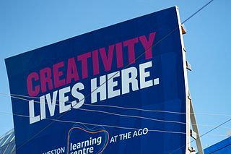
What is creativity?
Ideas that are original and useful (Byron, 2009)
A new combination or connection between ideas (Byron, 2009)

Slide 4

Who is creative?
Who can be creative?
How?
Creativity is absorbed ‘by osmosis’ through immersion in creative activity with other people (Byron, 2009).

Slide 5
Divergent and convergent thinking
Divergent thinking is associated with determining goals, exploring possibilities and generating ideas.
Asking questions that go beyond the remit of a problem statement.
Convergent thinking concerns decision making, analysing options and planning actions.
Asking questions within the remit of a problem statement to make a decision or conclusion.
When generating new ideas, we must first think divergently before converging.
Diverge
Converge
Create
choices
Make
choices
From Byron, K. (2009). The Creative Researcher. www.vitae.ac.uk/researcherbooklets

Slide 6
Divergent and convergent thinking
Diverge
Converge
Create
choices
Make
choices
Divergent thinking | Convergent thinking
Suspend judgement | Cluster similar statements/ideas
Include the obvious | Refine and combine statements/ideas
Go for quantity | Be decisive
Avoid editing
From Byron, K. (2009). The Creative Researcher. www.vitae.ac.uk/researcherbooklets

Slide 7
Introduction to creativity
Creativity in the research process
Creativity techniques (applied to research)
Digital creativity support tools (for after session)
Creativity strategies

Slide 8

When during academic research might creativity be important?

Slide 9
Creativity in the research process
From City’s MSc project guidance document: “Projects must give students the opportunity to demonstrate…
Originality in the application of knowledge.”
Originality in tackling and solving problems.”
The ability to deal with complex issues both systematically and creatively…”
Creativity can’t be directly taught and outcomes of creative thinking are unpredictable. So why try to be more ‘creative’?
“Understanding and developing creativity may not provide us with a better sense of knowing what we are doing when we are doing research, but…it may make us more efficient and productive researchers.” (Byron, 2009)

Slide 10
Research questions and aims
All research should have one or more clear aims – what the research seeks to accomplish (not how).
Research questions are aims, stated in the form of questions.
Examples from student projects:
Aim: Better understand how creative designers interact with information for the purpose of generating and developing ideas and how digital information tools can better support them
RQ: How do creative designers find, understand sand use information during the creative design process?
Aim: Design, develop and evaluate the usefulness of a digital tool for supporting Website users in providing feedback on the Visual Design of a site
RQ1: How can we best design a digital tool for users of a Website to provide feedback on its Visual Design?
RQ2: How successful is the digital tool?

Slide 11
Research objectives
Research objectives are how you will answer your research questions (or achieve your research aims)
e.g. Observe creative designers interacting with information as part of a real-world design project, survey the adequacy of existing digital information tools for supporting ideation etc.
e.g. Obtain requirements from potential users of the digital tool to guide the design, plan and conduct a formative or summative evaluation of the tool with potential users etc.
Objectives should be:
Strongly tied to the research question(s)/aim(s)
Highly focused and feasible
Described accurately and precisely

Slide 12
Originality
Research is “original investigation undertaken in order to gain knowledge and understanding” (HECFE, 2008).
Originality is doing something that has not been done before
So how do we make our research original?
Be original in our research process
e.g. doing something someone has done before but using a different technique or approach.
Be original in our research product
e.g. finding out something ‘new to the world’, designing something not designed before
Based on Dawson, C. (2015). Projects in Computing and Information Systems (3rd Ed). Chapter 2: Research.

Slide 13
Achieving originality in research: Cryer (2006)
Based on Dawson, C. (2015). Projects in Computing and Information Systems (3rd Ed). Chapter 2: Research.
Tools, techniques, procedures and methods
Appling new tools and techniques to existing problems
Or trying existing procedures and methods in contexts where they have not been applied before
Exploring the unknown
Exceptionally, you may find a field of research nobody has investigated before
Exploring the unexplored
Taking a ‘new direction’ in an existing field
Examining unexpected findings in previous research
Further developing previous research
Originality in using data
Interpreting data in new ways
Applying data in alternative areas not previously investigated

Slide 14
Creative research questions
Good research begins with good research questions:
“What most distinguishes those scientists noted by posterity is not their technical skill, but that they chose interesting problems” (Loehle, 1990)
Follow your instincts – challenge existing research by asking yourself:
Is there a more interesting or important research question than the one they answered?
Are there flaws in a paper’s existing approach that I could address?
Am I likely to be able to validate, extend, enhance or challenge their findings?

Slide 15

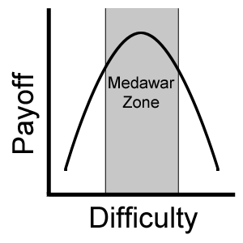
Creative research questions
Follow the fire engines (Loehle, 1990) – ‘where there’s smoke, there’s fire’
Is there intense debate in an area?
Inconclusive or contradictory research?
Terminological confusion?
If so, then it may be possible to think of a creative way to take sides
Stay in the Medawar zone (Madawar, 1967, The Art of the Soluble)
Posing a research question that is too simple has a low difficulty (easy to grapple), but also low payoff (not particularly important)
Posing a question that is too hard has high payoff, but frequently no payoff!

Slide 16

Creative research questions
Recognise problems nobody else can see
Be curious: ask how and why
Be sceptical: question conventional wisdom
Be naïve: ask the ‘obvious’ questions
Simplify: create abstractions
But don’t over-simplify
Do not remove all complexity
Surf each ‘idea wave’ as it comes
“Good ideas come sporadically and unpredictably and should be pursued as they pass by, just as the surfer pursues the wave.” (Loehle, 1990, p. 128).
Make notes (e.g. on your phone) when an idea strikes
When big ideas strike (e.g. a particularly promising research question), put everything else aside and look into its feasibility!

Slide 17
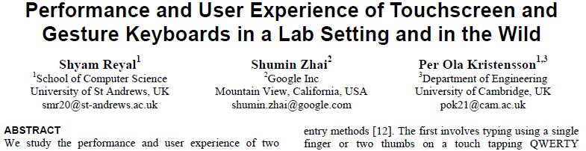
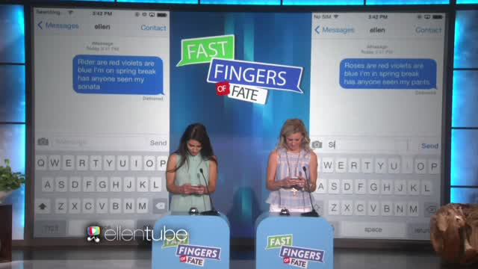
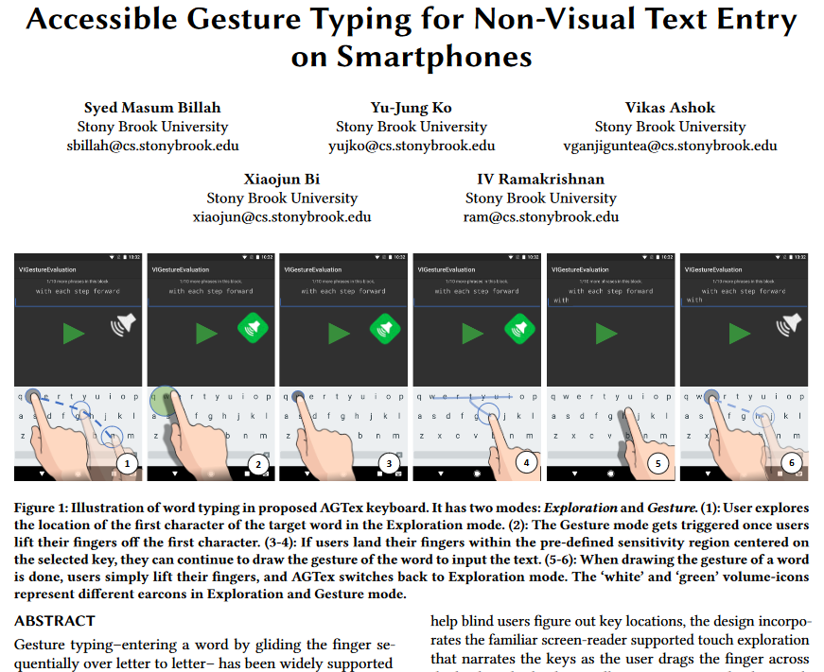
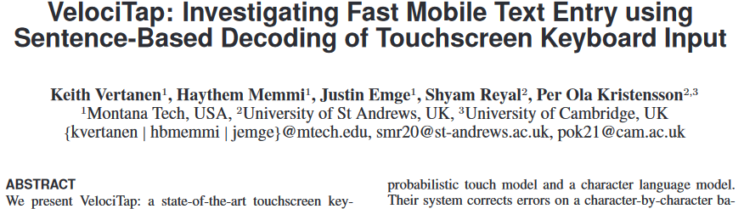
Activity: Creative research questions
https://youtu.be/NMbUAsmrisM?t=30
How would you make this ‘experiment’ academically rigorous?
What new academic research questions about smartphone typing come to mind after watching this?

Slide 18
Activity: Generating research questions
Use divergent thinking (e.g. brainstorming) to generate a broad range of academic research questions (4+ recommended).
These can be questions you might want to follow-up on for your project.
Or they might just be about topics you’re interested in.
If project-related, remember they are not final. Your project ideas are likely to change over the coming weeks and so will your research questions.
Remember to suspend judgment, include the obvious, go for quantity and avoid editing.
Post one of your research questions: https://pollev.com/stephann

Slide 19
Creativity in design and build projects
Design and build projects should involve research, when:
Gathering user requirements
Evaluating the success of the technology you design
Perhaps even applying a new design methodology
They should demonstrate not just technical skills, but also:
Analysis, explanation, argument, justification, critical evaluation and new knowledge creation (Oates, 2006)
“You can therefore claim to be doing research rather than ‘normal’ design and creation through the novelty and risk-taking or your software product or the process used” (Oates, 2006, p. 114).
If good design and build projects involve research…
And both design and research are partly creative activities…
…Then creativity is important (perhaps undervalued) in design and build projects!

Slide 20


Creativity in design and build projects
Design is an inherently creative process. Why?
You might design an original product that has not been created before (e.g. Shazaam service/app)
You might design a product that incorporates an original way of supporting users’ tasks (e.g. Nest learning thermostat)
You might follow and original design process, e.g. a:
New hybrid of established design methodologies
New process altogether

Slide 21

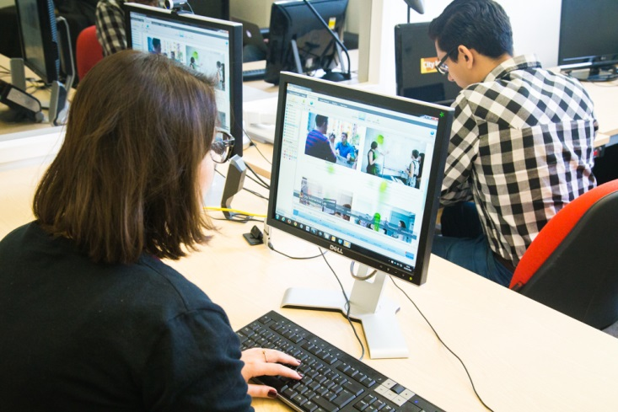


Creativity in data collection (MSc project examples)
Asking questions during think-aloud studies (reverse existing approach)
Taking screenshots as a replacement to text in a diary study (substitute components of an approach)
Conducting ‘Critical Incident’ observations of technology use (combine existing approaches)
Tailoring ‘expert’ user evaluation method for non-experts (modify existing approach)

Slide 22
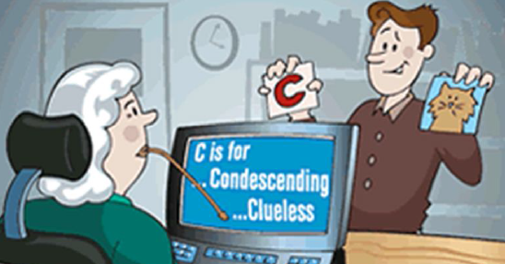




Creativity in data analysis
Look for patterns in data, but also findings that ‘don’t quite fit’
Investigate these further to find out why
Examine your findings from multiple perspectives
Be inquisitive
Ask ‘why?’ at successive levels of detail
Challenge your assumptions
Ask ‘is what I think I see in the data actually there?’
Be sceptical
Ask ‘am I sure this is what I’m finding?

Slide 23
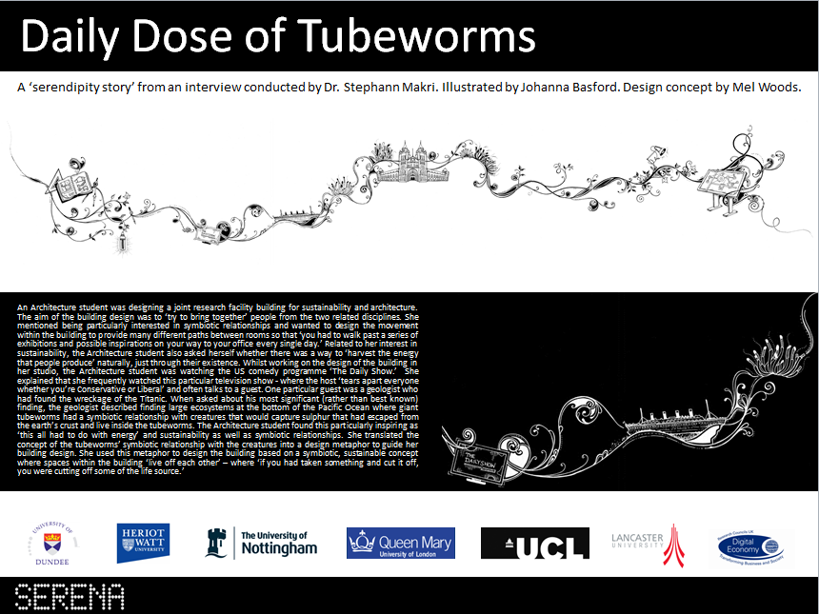
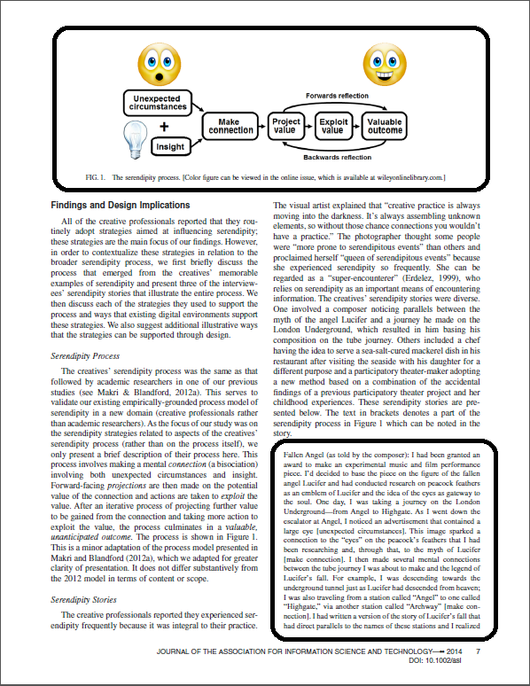

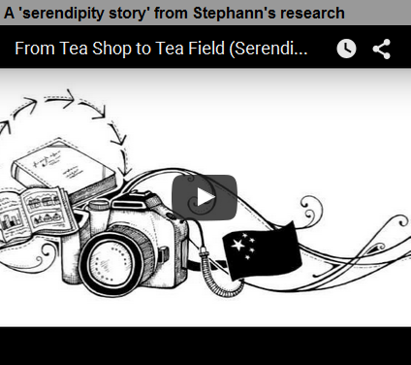
Creativity in data reporting
Explanatory model
‘Serendipity story’

Slide 24
Contextualising research questions
I keep six honest serving-men. They taught me all I knew; Their names are What and Why and When And How and Where and Who
Rudyard Kipling
What? - e.g. What is the aim of the research? What will success look like?
Who? – e.g. Who will the research benefit and how?
Where? – e.g. Where will the research take place?
When? – e.g. When will the research be carried out? When will there be benefits?
Why? – e.g. Why is the research important? (ask successively)
How? – e.g. How will the research be conducted (methods)?
From Byron, K. (2009). The Creative Researcher. www.vitae.ac.uk/researcherbooklets

Slide 25
Scoping research questions (asking ‘why’ successively): Example
Original research question: 'How can I design a digital tool to support creative research?’
Q: Why should I design a digital tool to support creative research?
A: To support academic researchers in generating creative ideas during research.
Q: Why should I support researchers generating ideas during research?
A: So researchers can generate a greater quantity and quality of original research ideas, and more frequently.
Scoped research question: 'How can I best design a digital tool to support academic researchers in generating creative ideas during research?'

Slide 26
Activity: Contextualising and scoping research questions
Use convergent thinking to choose your favourite 1 or 2 research questions from the list you produced. You may later decide to refine one of these for your project, but do not have to.
To help choose, contextualise your questions by asking yourself:
What is the aim of the research? What will success look like?
Who will the research benefit and how?
Where will the research take place and when?
Why is this research important?
How will the research be conducted (rough method)?
Scope your favourite question(s) by asking yourself 'why?' successively. Ask someone sitting near you to help you answer some of your 'why' questions.
When thinking convergently, remember to be decisive, cluster similar project ideas, refine and combine ideas.
Post your favourite research question: https://pollev.com/stephann

Slide 27
Introduction to creativity
Creativity in the research process
Creativity techniques (applied to research)
Digital creativity support tools (for after session)
Creativity strategies

Slide 28



Techniques for research creativity: Byron (2013)
Take risks
Be ambitious (but not so ambitious that you can’t do it!)
Tolerate ambiguity
Be comfortable with unresolved issues for longer
Trust in the incubation process
Recognise there is no single ‘right’ way to answer a research question (or to ‘do’ research)
Recognise when you ‘do not know’ and accept it
Then do your research to find out
Trust your intuition
But also question it, as your assumptions may not hold
Check or reverse your assumptions regularly
Try multiple approaches
Suspend judgement until you have explored them all

Slide 29

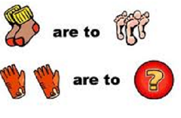



Techniques for research creativity: Greenfield (2002)
Based on Dawson, C. (2015). Projects in Computing and Information Systems (3rd Ed). Chapter 2: Research.
Random guesses
Research problem is solved by generating a number of potential solutions at ‘random’ (similar to brainstorming)
Hopefully a solution will make sense and work
Reasoning by analogy
Asking ‘is the problem similar to anything else that already has a solution or explanation’?
Inversion
Looking at the problem from an opposite angle
e.g. instead of ‘which research method(s) should I use?’ ask ‘why shouldn’t I use surveys/interviews/observations?’
Partition
Breaking down the problem into smaller, more manageable and understandable parts

Slide 30

Applying reasoning by analogy in research
Adapted from www.mycoted.com/Analogies
An analogy is when we say something is like something else in some respects, but not others
e.g. time is like money; both are precious, both can be saved, both can run out BUT we can make more money but not time etc.
Identify what you want ideas for and form a core verb phrase to capture the functional nature of what you are looking for.
e.g. ‘how to design X,’ how to prevent Y,’ ‘how to ensure Z.’
Generate a list of possible items like it in some way (e.g. having a baby, baking a cake, a mad scientist, supermarket shelves)
Describe one of the interesting analogies, including:
Active aspects (e.g. how it works, what it does, how it is used)
Passive aspects (e.g. size, position, format, appearance)
Use your description to suggest ideas relevant to your problem
Use features of the analog directly or differences to suggest other ways of looking at your problem.

Slide 31


Activity: Reasoning by analogy in research
“Managing money is like…”
You want to design a novel (original) mobile app to encourage young adults to manage their personal finances better
During a requirements gathering focus group, target users stated the need to make sure the app is not ‘boring’ or ‘prescriptive’
Young adults should actually want to use it regularly
Use reasoning by analogy to think of some original design ideas

Slide 32
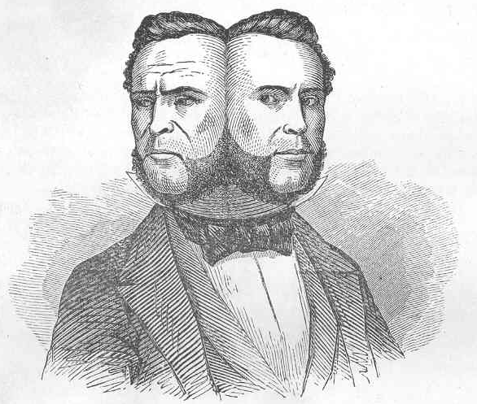
Techniques for research creativity: Pair up (2 heads are better than 1)
We are better at making creative decisions for other people than we are for ourselves (Polman & Emich, 2011).
Feedback is important because the other person may:
Be less familiar with the research
So could help you see ‘the wood from the trees’
Provide an alternative perspective on the research
So could help you make a ‘mental leap’ or overcome an impasse
Challenge your assumptions about the research
So could help you improve your understanding
Polman, E. & Emich, K. (2011). Decisions for Others Are More Creative Than Decisions for the Self. Pers. Soc. Psychology Bulletin 37(4), 492-501.

Slide 33







Techniques for research creativity: SCAMPER
Substitute – Substituting copper cable for optical fibre revolutionised broadband
Combine – Mobile phone was combined with camera and MP3 player
Adapt – Roll-on deodorant is an adaptation of ballpoint pen
Modify (magnify/minify) – All-you-can-eat restaurants
Put to other uses – Velcro is attachment mechanism of cockle-burrs put to another use
Eliminate – WiFi eliminates electrical cables
Reverse – Nandos reversed traditional restaurant ordering process by getting customers to pay first, then eat

Slide 34
Introduction to creativity
Creativity in the research process
Creativity techniques (applied to research)
Digital creativity support tools (for after session)
Creativity strategies

Slide 35
Digital creativity support tools
General purpose digital productivity tools used in a creative way
e.g. Google Docs, Hangouts, Skype
Digital tools that replicate physical ‘creativity tools’
e.g. Digital whiteboards, digital post-its, mind mapping tools
Digital tools that explicitly aim to augment human creative capabilities
Domain-specific tools
e.g. Photoshop, Computer-Aided Design tools
Generic problem-solving tools – e.g. those supporting analogical reasoning
Tools that ‘do’ the creativity for the user
e.g. semi-automated story writing tools, Web design tools etc.
Acknowledgement: Dr. Sara Jones

Slide 36
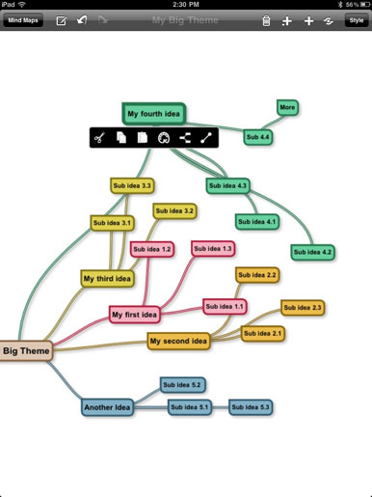
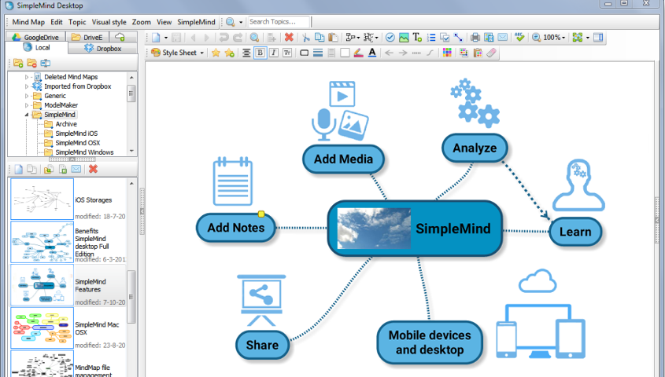
SimpleMind Free
Free mindmapping tool for mobile, tablet, desktop
simplemind.eu

Slide 37
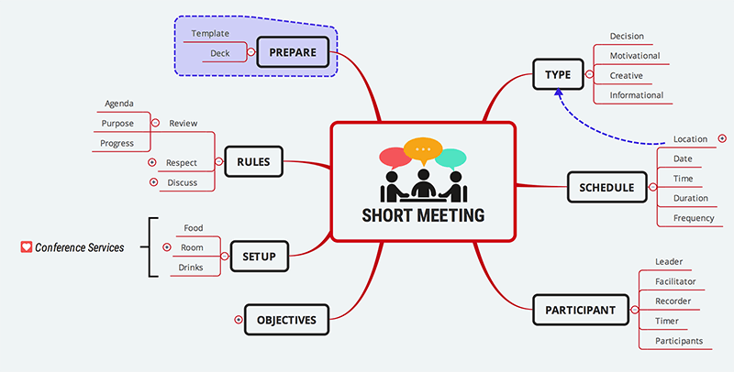
Xmind for Windows
Free mind mapping tool (also saves to Evernote, shares to social networks)
www.xmind.net

Slide 38
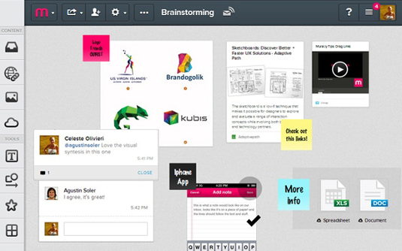
Mural
Collaborative mind mapping, brainstorming, media sharing, sketching and chat (30 day free trial)
http://mural.co

Slide 39
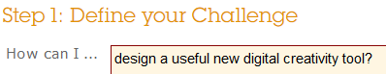

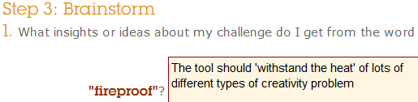
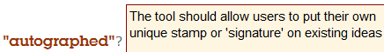
Idea Champions - Jumpstart
Online form that prompts idea generation and development.
www.ideachampions.com/jump_start_new.shtml

Slide 40
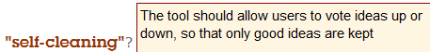
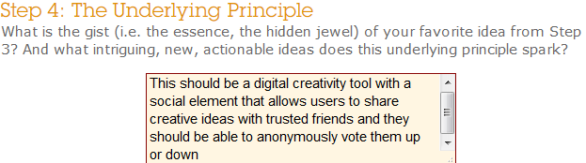
Idea Champions - Jumpstart
www.ideachampions.com/jump_start_new.shtml

Slide 41

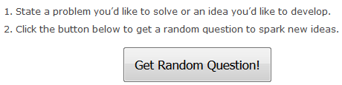
SCAMPER Random question tool
https://litemind.com/scamper-tool

Slide 42
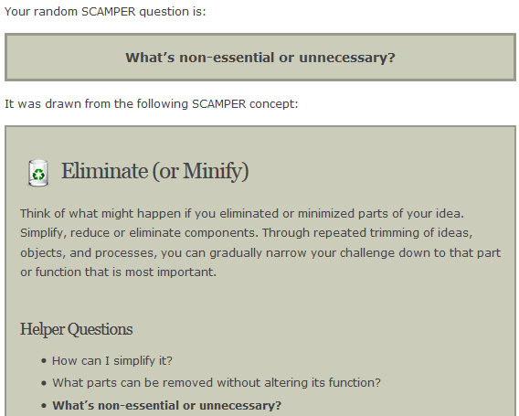
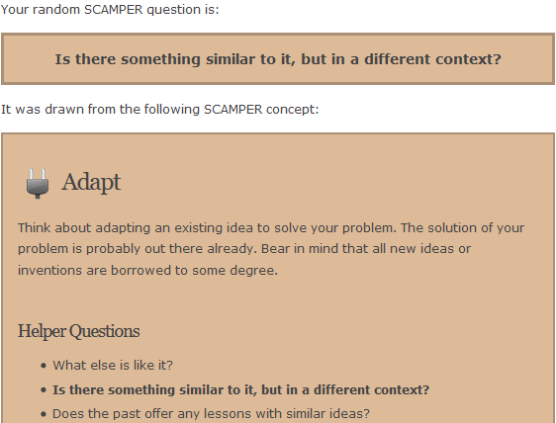
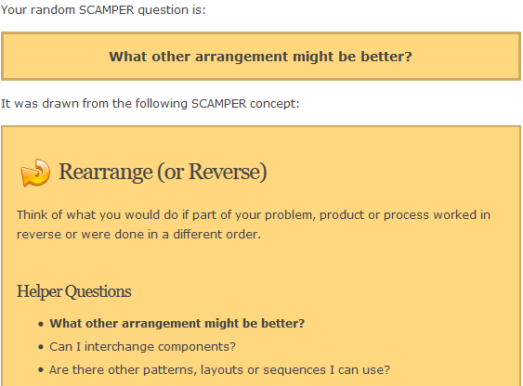
SCAMPER Random question tool
https://litemind.com/scamper-tool

Slide 43
Introduction to creativity
Creativity in the research process
Creativity techniques (applied to research)
Digital creativity support tools (for after session)
Creativity strategies

Slide 44
Strategies for ‘seeking serendipity’ ‘creating creativity’
Makri, S. et al. (2014). Making my Own Luck: Serendipity Strategies and how to Support them in Digital Information Environments. JASIST 65(11), 2179-2194.
Makri et al. (2014) interviewed 14 creative professionals, asking:
Do you do anything that you think increases the likelihood of serendipity happening to you?
Creatives identified 7 strategies for ‘seeking serendipity’ that might also be able to ‘create creativity.’
Vary your routine
Be observant
Relax your boundaries
Draw on previous experiences
Look for patterns
Make mental space
Seize opportunities

Slide 45

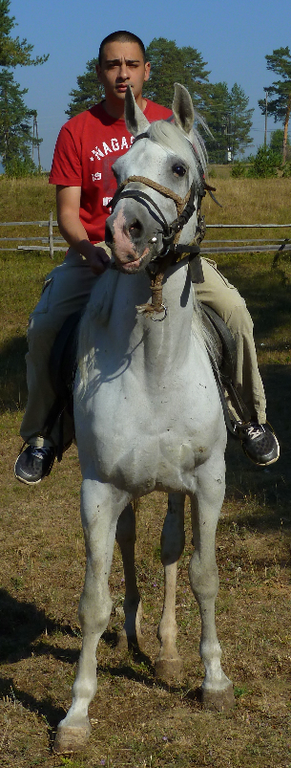
Vary your Routine
Notes:
Nesta, an organisation aimed at nurturing business innovation, encourages its staff to vary their routines through the introduction of Randomised Coffee Trials – where staff who opt in are sent a weekly randomised match with another staff member and are invited to have coffee together and discuss whatever they choose to. This resulted in staff noticing unexpected synergies between their work and feeling comfortable approaching their new coffee mates in the future in order to collaborate. They found the coffee trials helped Nesta to break silos and gave staff the chance to make time to talk to people they should be talking to anyway.

Slide 46

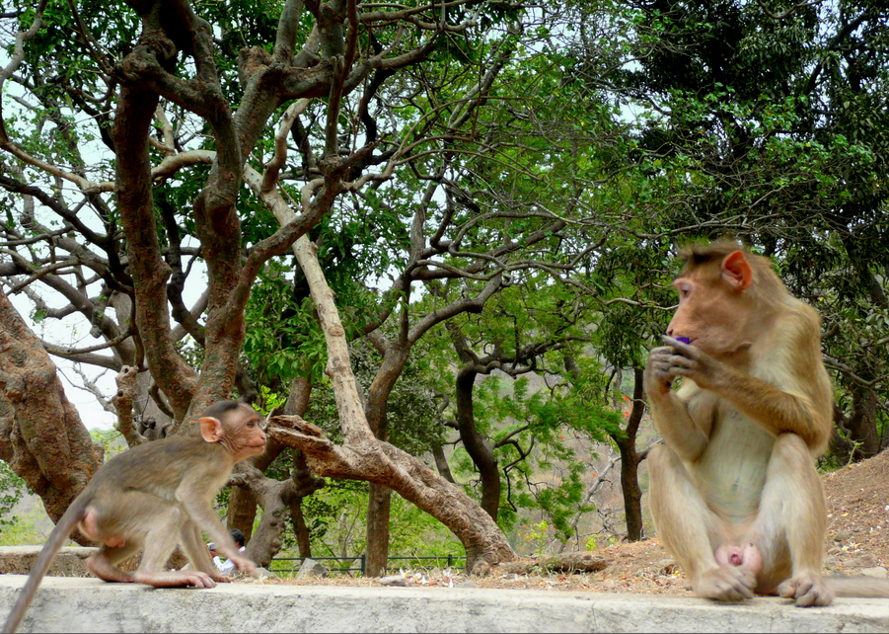
Be Observant
Notes:
Being observant involves not only using our senses – keeping our eyes and ears open, but also regularly rehearsing our senses by stopping to observe aspects of the environment around us. This means noticing changes (new people, new projects) and being inquisitive to find out more about these changes in the environment – the interests and expertise of the new people, the aims and objectives of the new projects.
The composer asserted that being observant could be supported by ‘attuning’ oneself to things of interest so as to ‘see conjunctions’ in the environment related to those interests:
“Some conjunctions slap you in the face and you can’t ignore them, but not all of them do.” - Composer

Slide 47
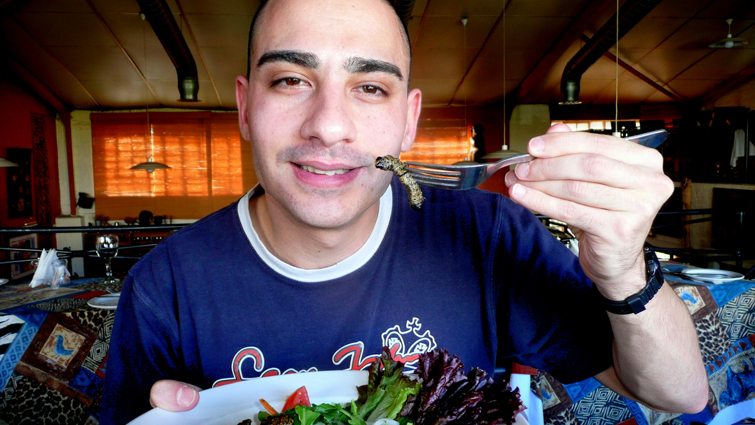
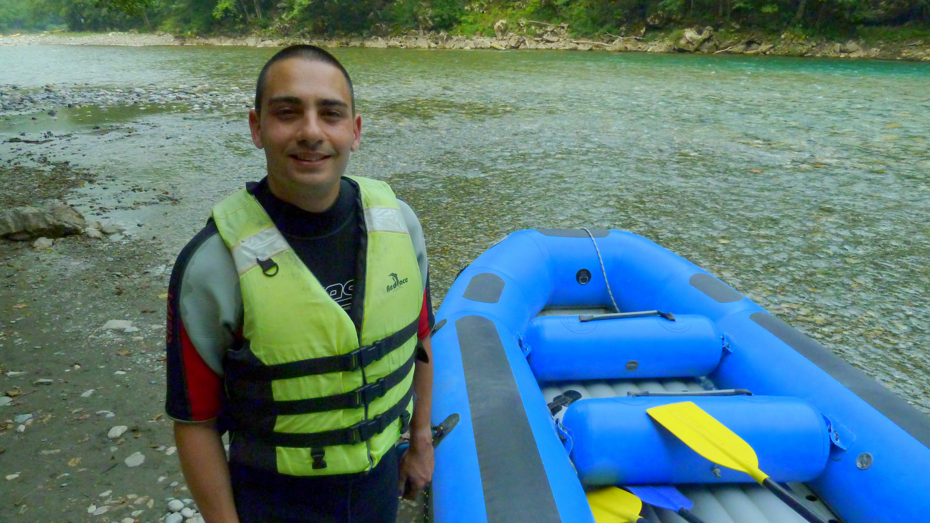
Relax your Boundaries
Notes:
“If you have rigid boundaries between areas of knowledge, or areas of the world, whether intellectually or physically, you will cut off certain possibilities. Even literally, if you obey ‘No entry’ signs every time you see them. Having a healthy disrespect for boundaries is pretty important.” – Visual artist

Slide 48
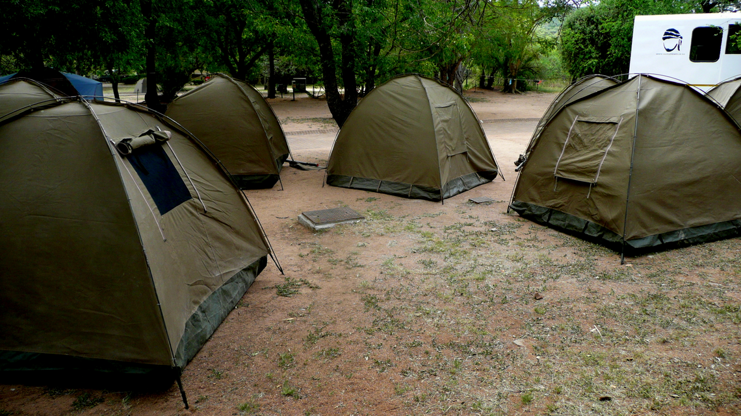
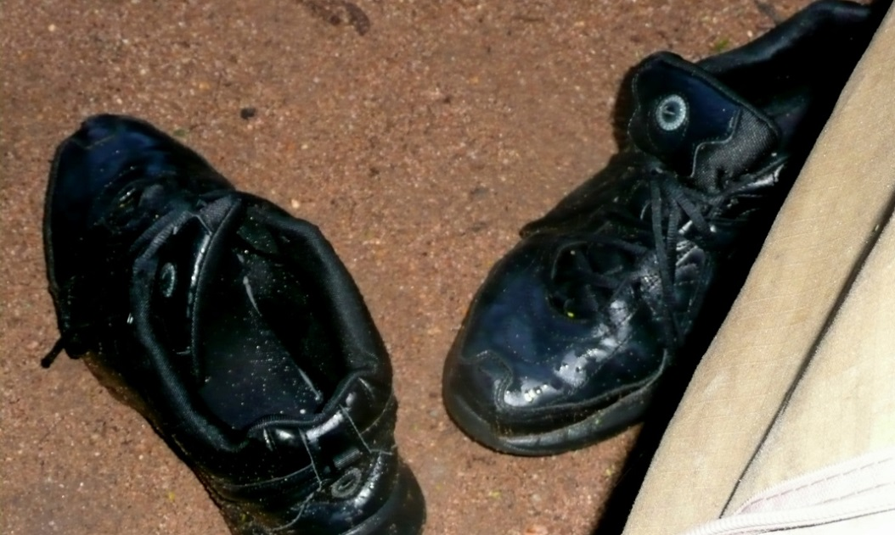
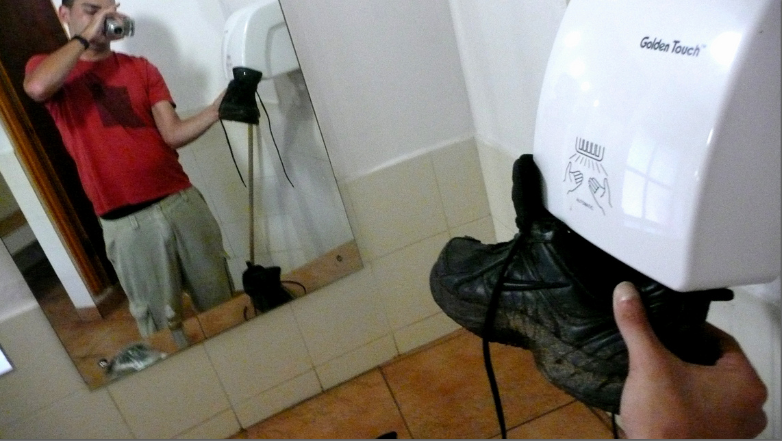
Draw on Previous Experiences
Notes:
Creativity “aligns disparate elements, but you have to have access to those elements in some way and that's a function of memory, storage, sensitivity and self-archiving of memory.” – Visual artist

Slide 49

Look for Patterns
Notes:
“There's a potter who I've worked with quite a lot. He's 90 now and tends to make big thematic statements. He said to me ‘people think there's patterns in the world. There isn't; it's chaos. But what we’re here to do is to look for patterns. That's our purpose.’” – Participatory theatre maker

Slide 50

Make Mental Space
Notes:
This means putting yourself in an environment and adopting a mindset that allows you to ‘step back’ from the things you are working on – to put them out of your mind in order to allow that ‘aha’ moment to happen when it’s ready to. This might mean occasionally having lunch in the park, or meditation, or yoga.

Slide 51

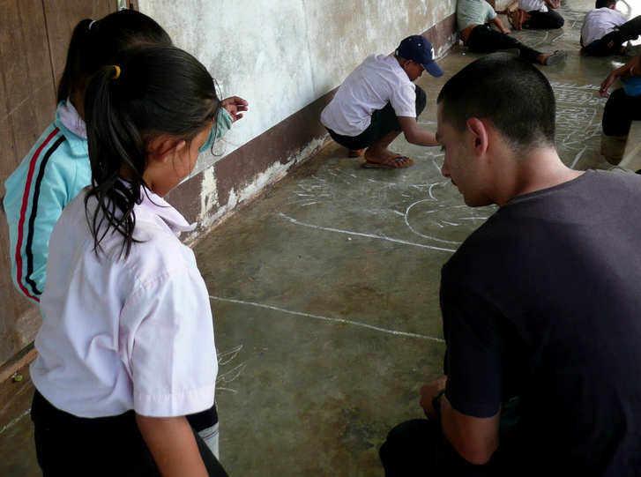
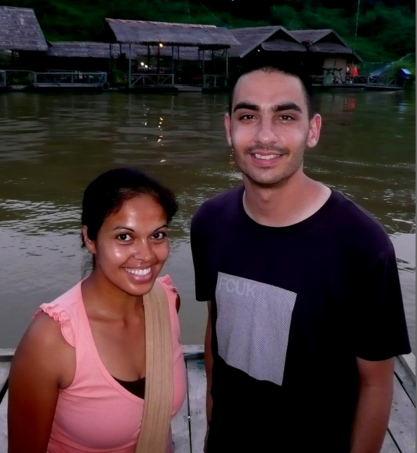

Seize Opportunities

Slide 52
How might you use some of these strategies to be creative in research?
Vary your routine
Be observant
Relax your boundaries
Draw on previous experiences
Look for patterns
Make mental space
Seize opportunities

Slide 53




Varying your routine in research
Read a variety of previous literature, using multiple sources
e.g. City’s library catalogue library.city.ac.uk, Google Scholar, ACM/IEEE Digital Libraries etc.
Browse the library shelves rather than only search online
Resist temptation to only apply methods you already know
Discuss your research ideas/findings with others:
Supervisor, others researchers in the field, classmates

Slide 54


Being observant in research
Look out for:
Limitations in prior approaches (so you can improve on them)
Opportunities to follow new research directions or repeat existing research with a new approach or research ‘angle’

Slide 55
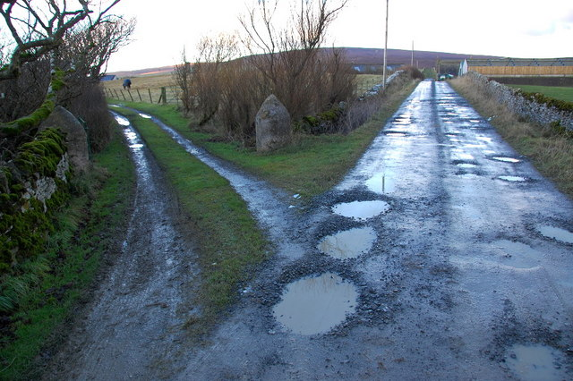

Relaxing your boundaries in research
Take an interest in a broad range of computing topics
But also look for research outside of computing that might allow you to examine your findings from a new perspective
Take the road less travelled – be ambitious, take risks!
But not too ambitious or risky, as you want a successful project

Slide 56


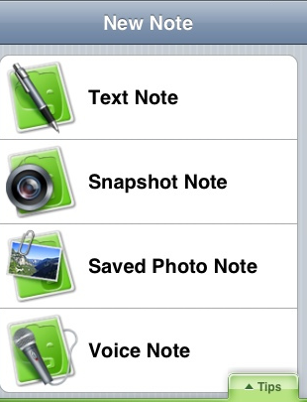
Drawing on previous experiences in research
Leverage your academic interests
e.g. topics you have particularly enjoyed in a module
Leverage your personal interests
Provided you can integrate them into an academic computing context
Keep a research diary and review it regularly
Write your research questions, ideas/questions to follow up on, assumptions about your findings etc.

Slide 57


Looking for patterns in research
Examine trends in your research field or topic of interest to help you identify new research directions
Examine interesting or unexpected findings
In previous and your own work

Slide 58


Making mental space during research
Regularly step back from your research questions and findings to facilitate incubation
Change activity
Go for a walk, practice yoga, meditate

Slide 59


Seizing research opportunities
Perhaps you have access to a unique or difficult-to-access:
Pool of research participants
Dataset?
Equipment?
Take advantage!
Follow up on your unexpected or surprising findings
When research gives you lemons, make lemonade!

Slide 60
Activity: Vary your routine
Pair up with someone nearby (e.g. on the same row) you have not spoken to before and discuss one of your favourite research questions with them.
Ask them to provide a new perspective or suggest a new 'twist' on your question.
After the session: Discuss your favourite research question(s) in a group of 2 or 3 your peers, again asking them to suggest a new perspective or 'twist' on your question.

Slide 61
Reading and resources
Essential:
Byron, K. (2009). The Creative Researcher. On Moodle.
Creswell, J.W. (2014). Research Questions and Hypotheses. In Research Design: Qualitative, Quantitative and Mixed Method Approaches. Thousand Oaks, CA: SAGE Publications. On Moodle.
Recommended:
Dawson, C. (2015). Projects in Computing and Information Systems (3rd Ed). Chapter 2: Research. 2nd Ed. is fine too.
Loehle, C. (1990). A Guide to Increased Creativity in Research: Inspiration or Perspiration? Bioscience 40(2), 123-129.
Makri, S. et al. (2014). Making my Own Luck: Serendipity Strategies and how to Support them in Digital Information Environments. JASIST 65(11), 2179-2194.
Mycoted (2011). Creativity and Innovation Techniques – an A-Z. www.mycoted.com/Category:Creativity_Techniques
Oates, B. (2006). Researching Information Systems and Computing (2nd Ed.). Chapter 8: Design and Creation.

Slide 62
More questions?
Please also ask questions in Moodle Discussion forum

Slide 63
Can you think creatively?
Example: ECNALG [2 words]
Answer: Backward glance
BAKED [2 words]
|R|E|A|D|I|N|G| [4 words]
CI II [4 words]
Their are four errers in these two sentences. Can you spot what they are and and write them down?
From Byron, K. (2009). The Creative Researcher. www.vitae.ac.uk/researcherbooklets

